Slide 1



Master Thesis Defense
Design and Control of a Ball and Plate Didactic Device
Author : Jihad Alsamarji
Supervisor : Prof. Dr. Ir. Micheal Kinnaert
Ir. Laurent Catoire
Co-supervisor : Dr. Ir. Christoph Mertens

Slide 2
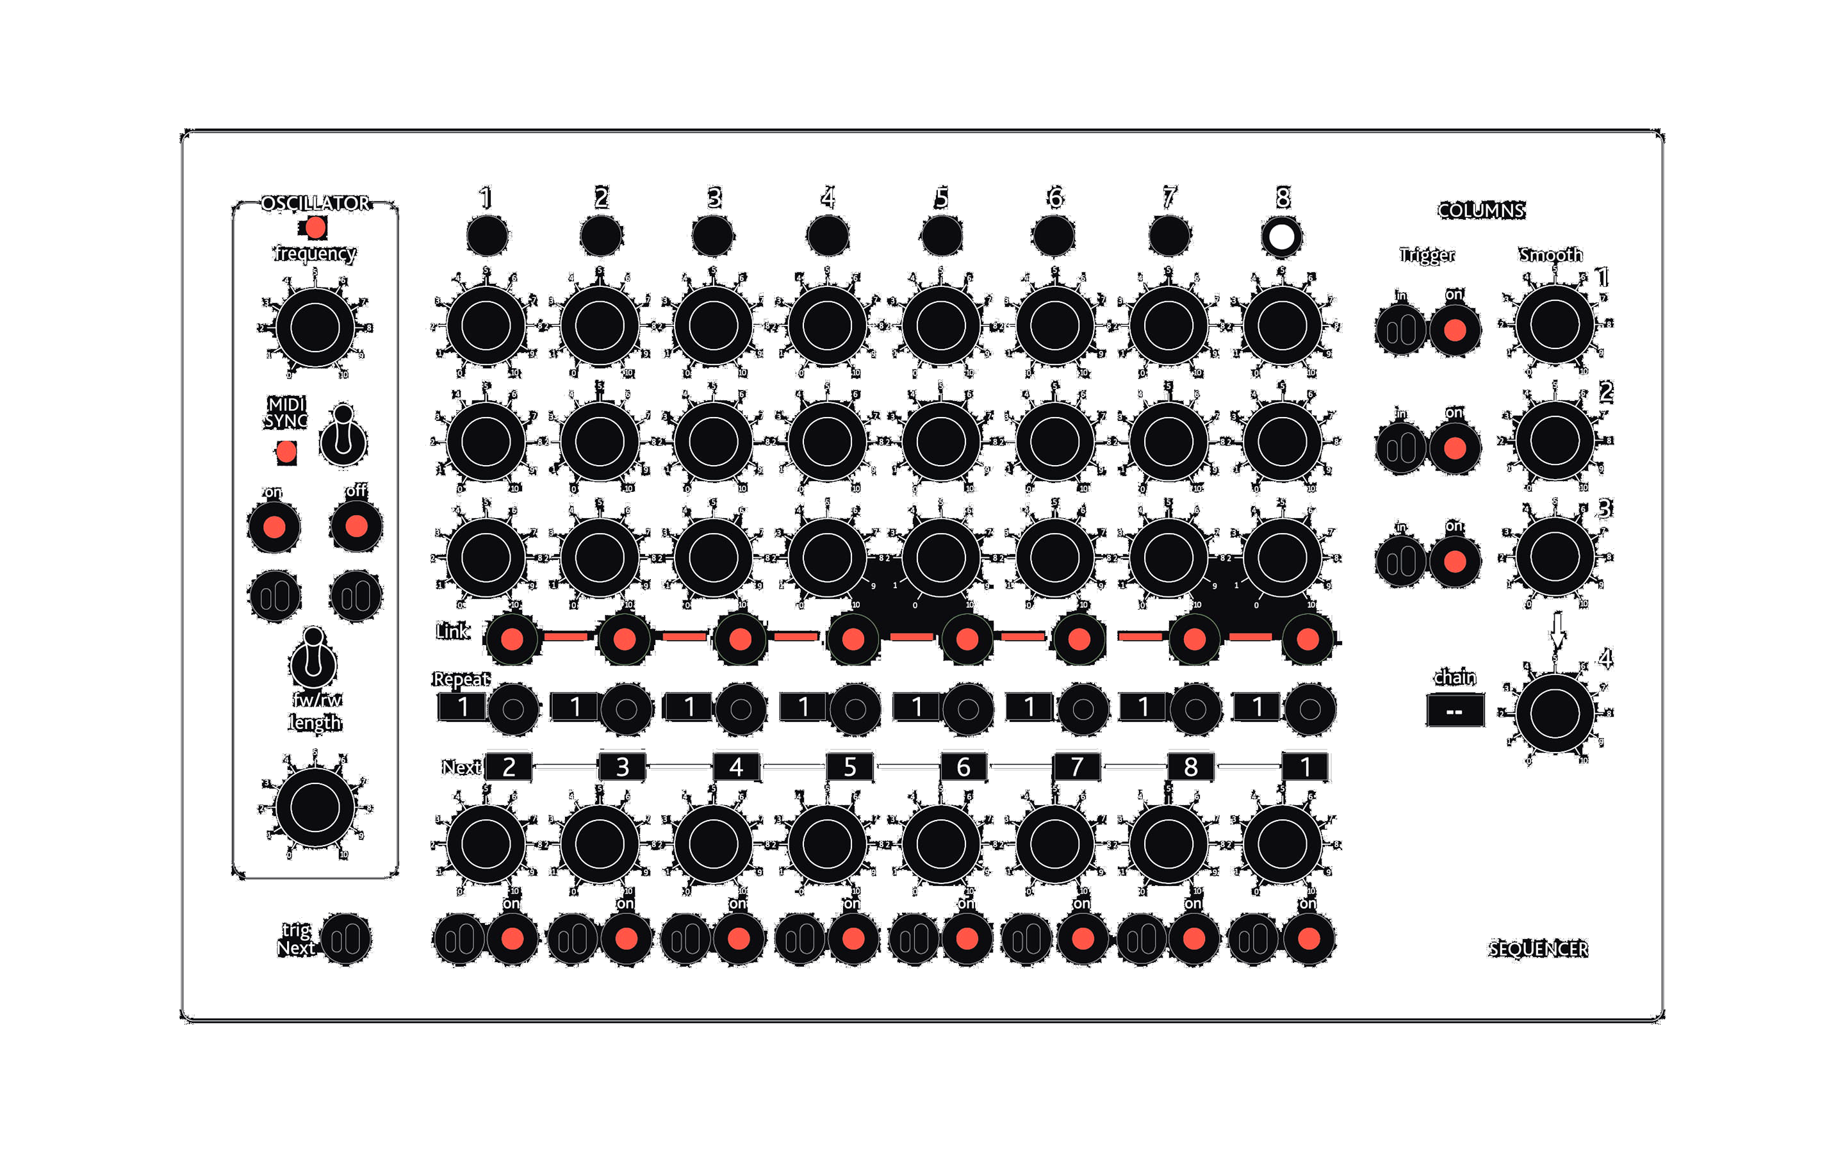
Notes:
Control system design is one of the hardest courses taught in engineering.
It has myriad of applications in mechanical,electrical,biomedical and many other disciplines.
One of the reasons why this course is hard for some students is that this sector contains so much maths which is abstract.

Slide 3
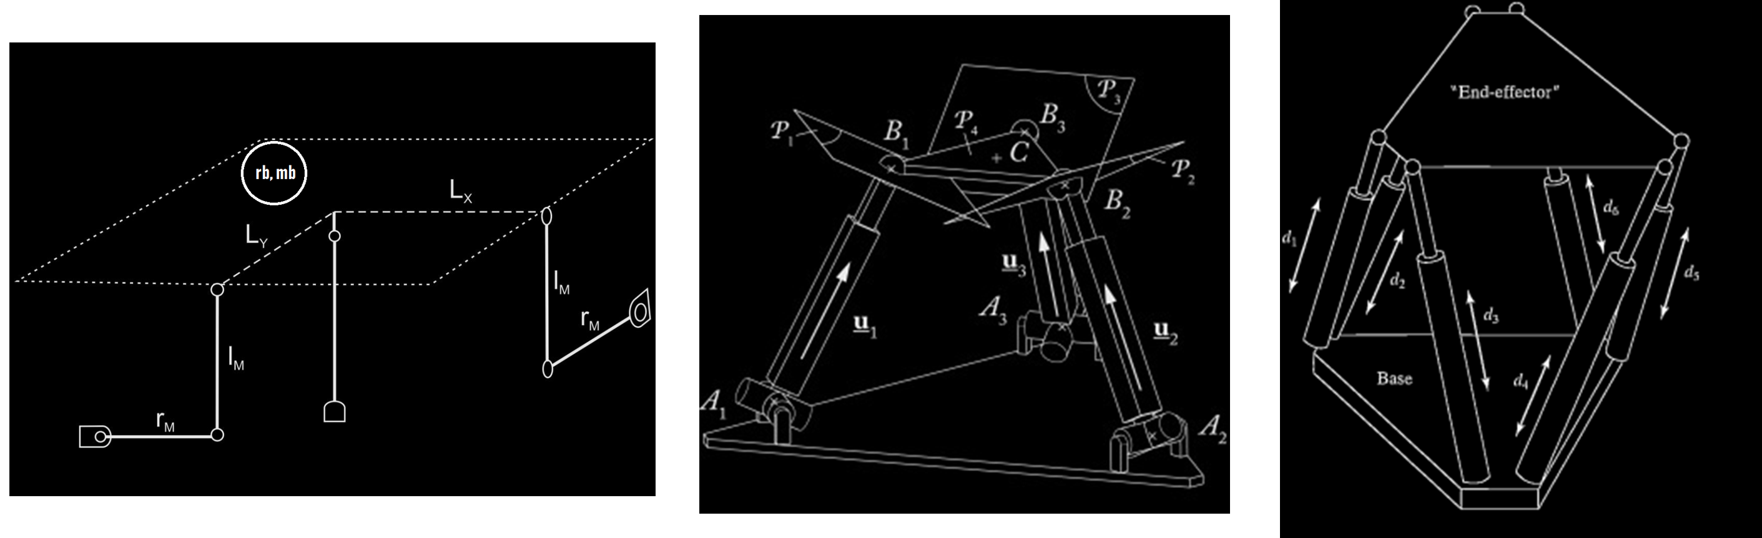
Plant Selection
- Portable
- Safe
- Affordable
- Controllable
- Scalable
- Convenient
2DOF
3DOF
6DOF
Notes:
Control system design is one of the hardest courses taught in engineering.
It has myriad of applications in mechanical,electrical,biomedical and many other disciplines.
One of the reasons why this course is hard for some students is that this sector contains so much maths which is abstract.

Slide 4
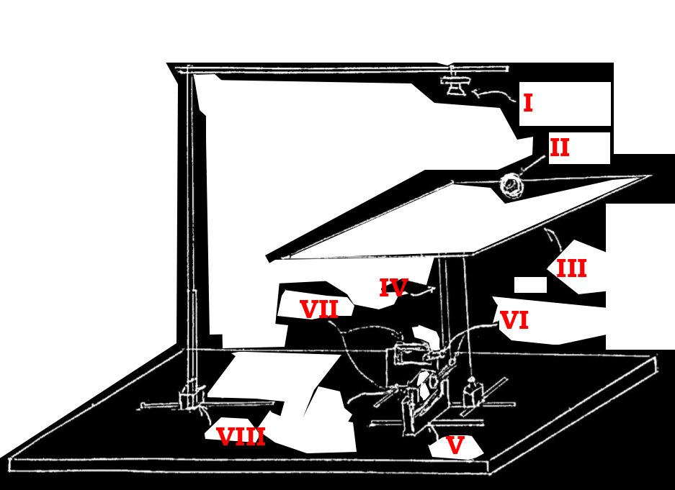
Conceptual Design
Sensor
Actuator
Processing Unit
Camera
Resistive Touchscreen
Step Motor
Servo Motor
Arduino
RasberryPi
Custom Made PCB
Computer
Notes:
Control system design is one of the hardest courses taught in engineering.
It has myriad of applications in mechanical,electrical,biomedical and many other disciplines.
One of the reasons why this course is hard for some students is that this sector contains so much maths which is abstract.

Slide 5
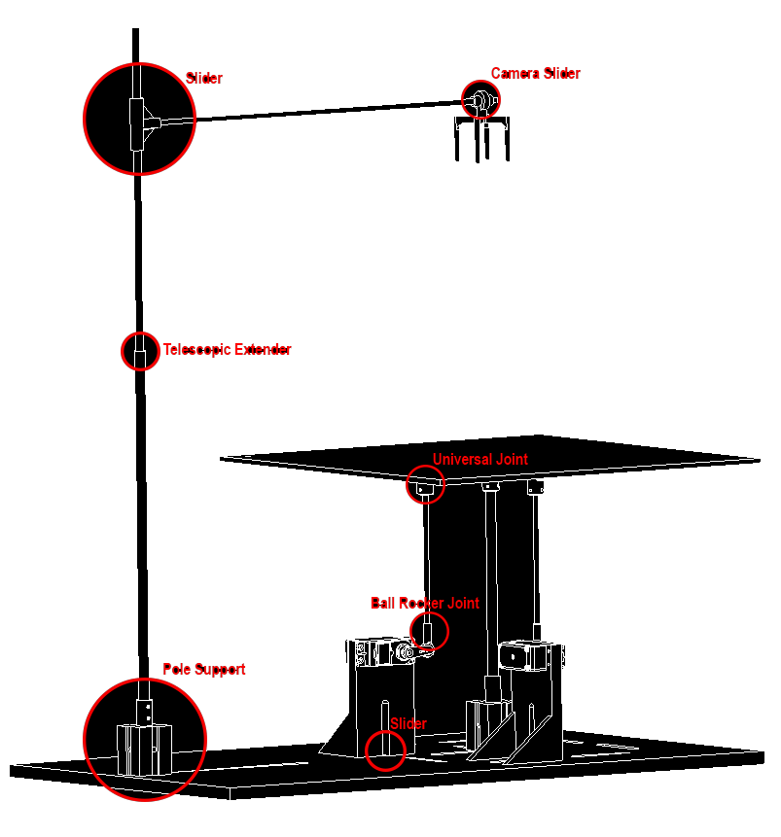
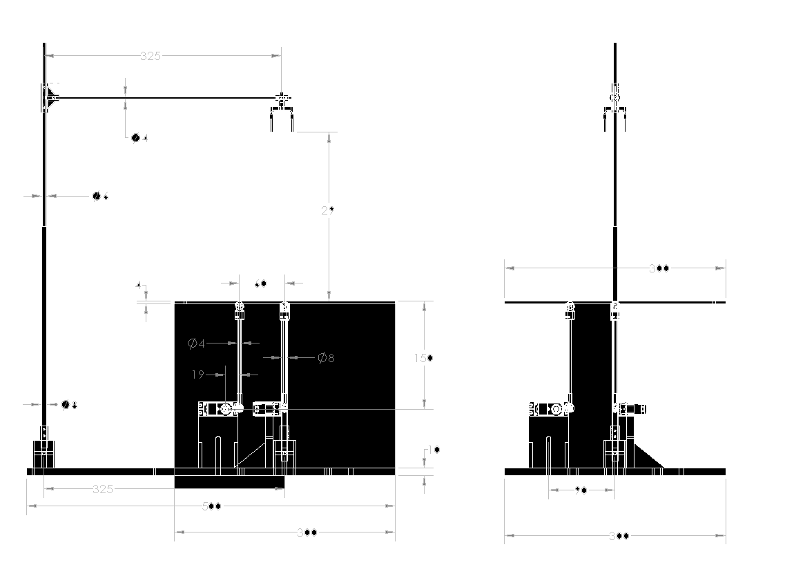
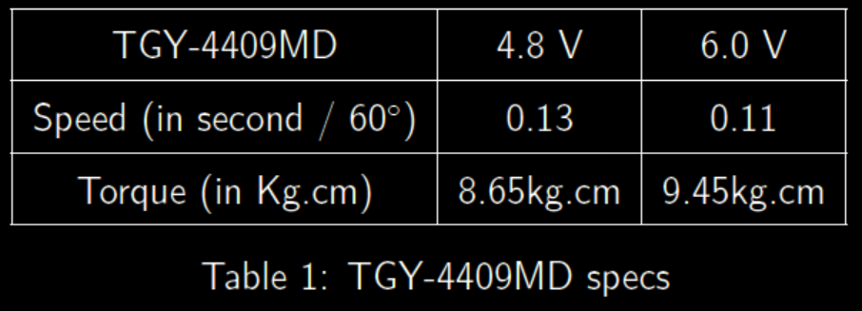
Mechanical Design
Size of the actuated plate (30x30cm)
Height of the actuated plate (27cm)
Size of the supporting bench (50x30cm)
Size of the servo frame (Standard Size)
Material and thickness for plate and bench (4mm Plywood)
Material for actuating rods and Camera Support (Carbon fiber)
Material for Additional Supporting structure (PLA 3d printed)
Using a ball of 0.1 [Kg,] and assuming a critical situation that the plate is handled by one servo motor. The required torque is then roughly speaking 0.42 [Kg.cm]. A customizability factor of 2 is used. To ensure that the servo motor operates in the Continuous region, a rule of thumb is to use a 10x multiplier. Hence the required torque is now 8.4 [Kg.cm].
Connection between Rods and Servo Arm (Rod End Bearing or Rocker Ball Joint)
Connection between Rods and Plate (Universal Joint or Magnetic Ball Joint)
Ratio K = dc / dm
Flexibility and customization using slideways.
Accuracy and Response Speed

Slide 6
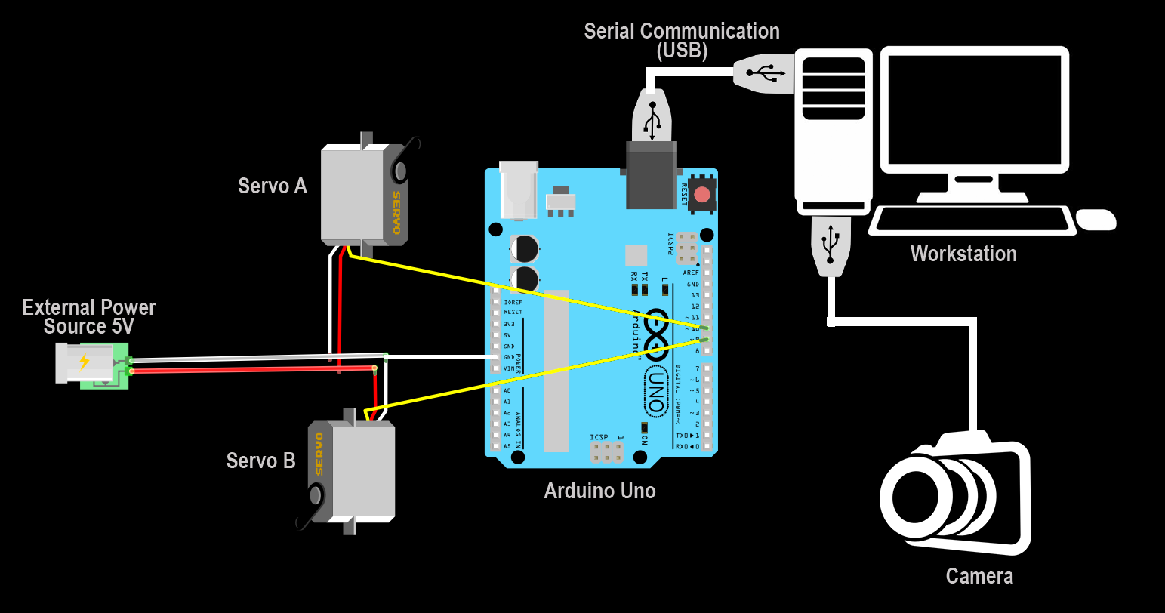
Electrical Design

Slide 7
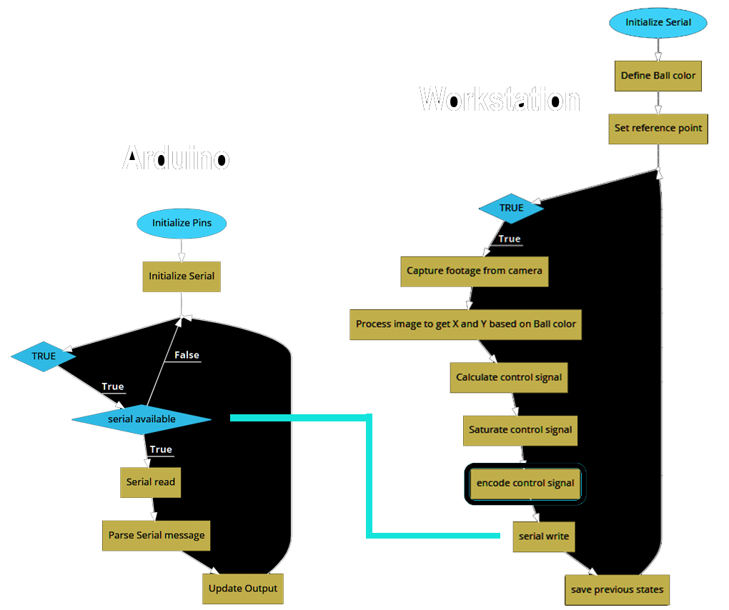
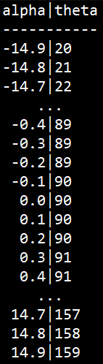
Software Design
Lookup Table

Slide 8
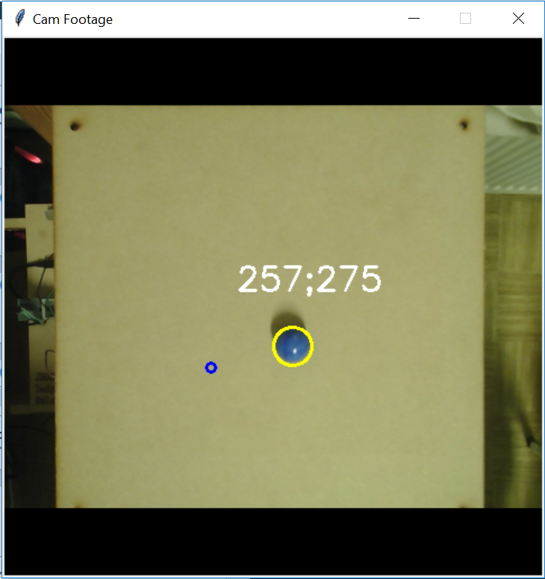
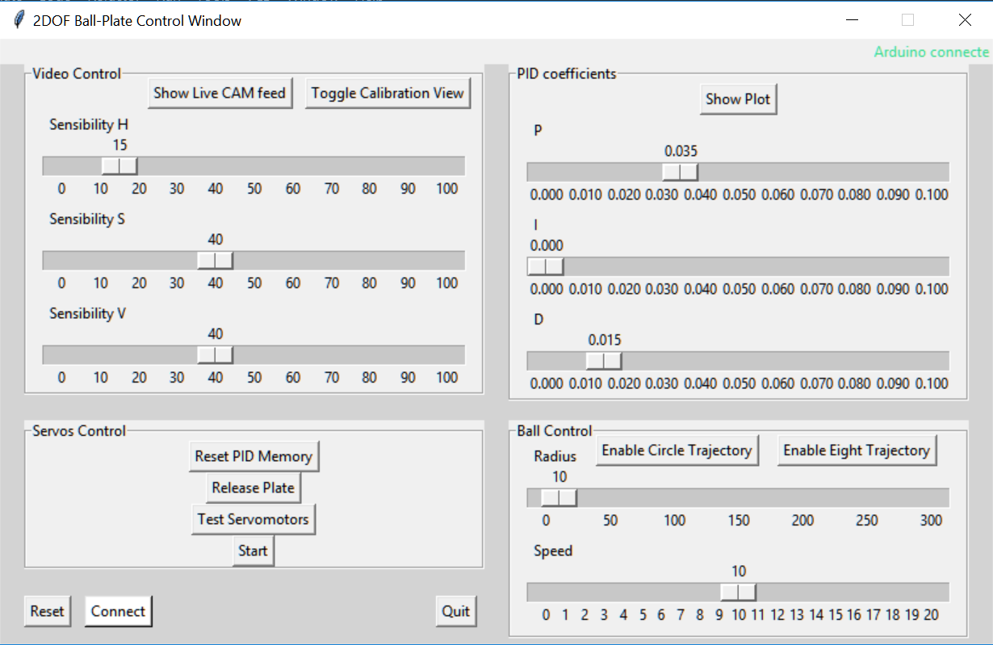
Software Design
Notes:
The lookup table is to map between the angle theta and alpha since the relation between them is non linear and we don’t want to solve for it analytically each cycle

Slide 9
Modelling

Slide 10
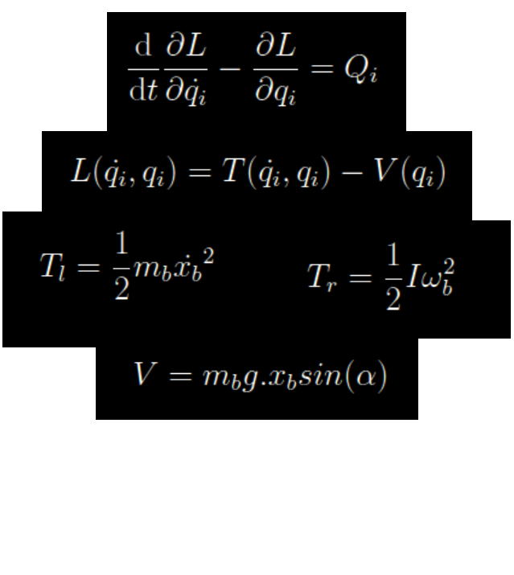
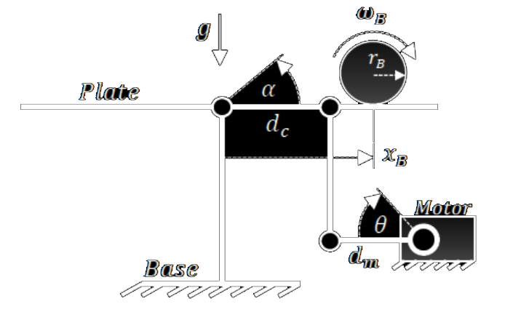
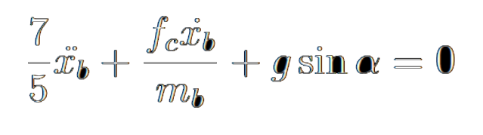
System Dynamics Modelling
Equation of motion of the Ball Obtained By LaGrange formulation :

Slide 11
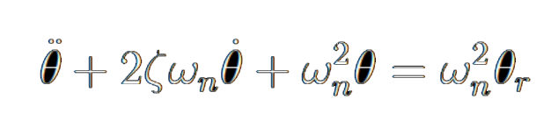
System Dynamics Modelling
Equation of motion of the Servo motor obtained by second order assumption :
Needs Validation !
Determine parameters by identification !

Slide 12
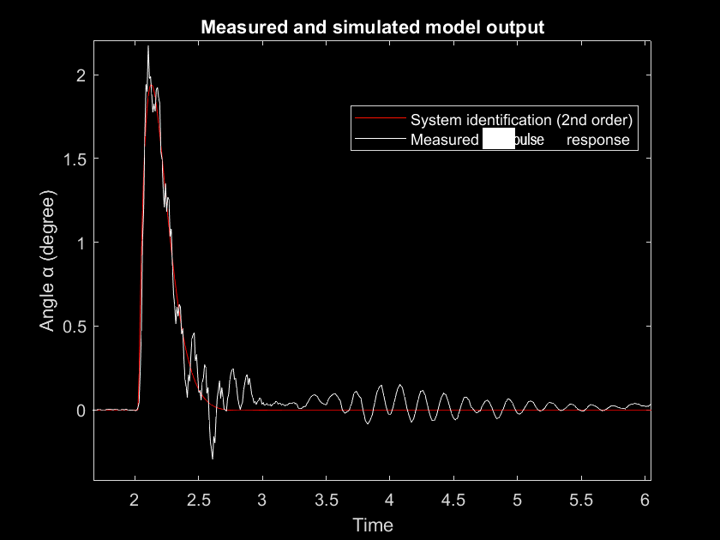
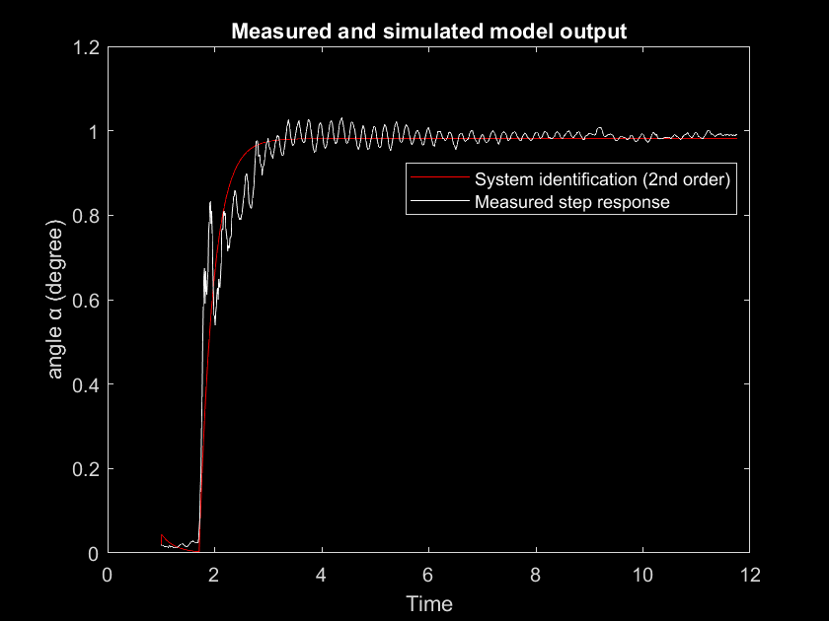
System Identification : Servo Motor Dynamics

Slide 13
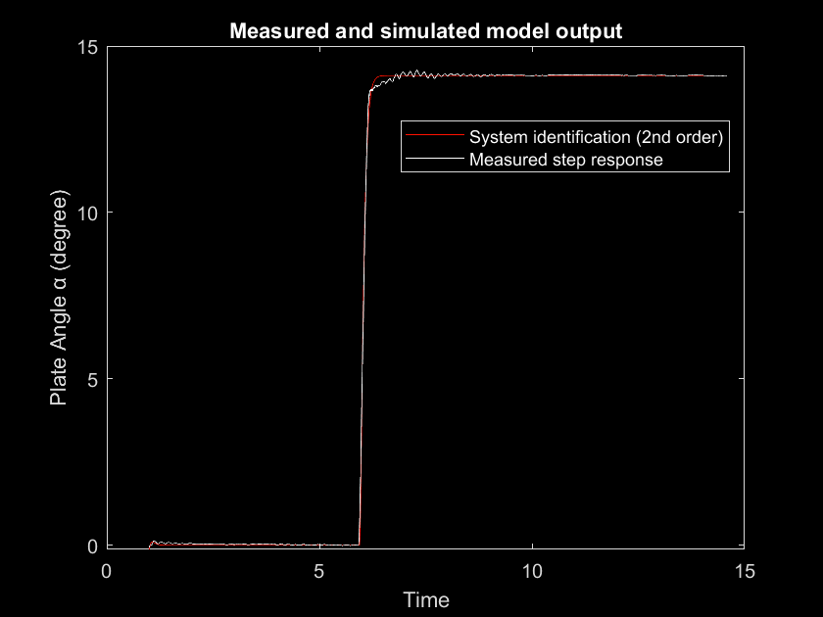
System Identification : Servo Motor Dynamics

Slide 14
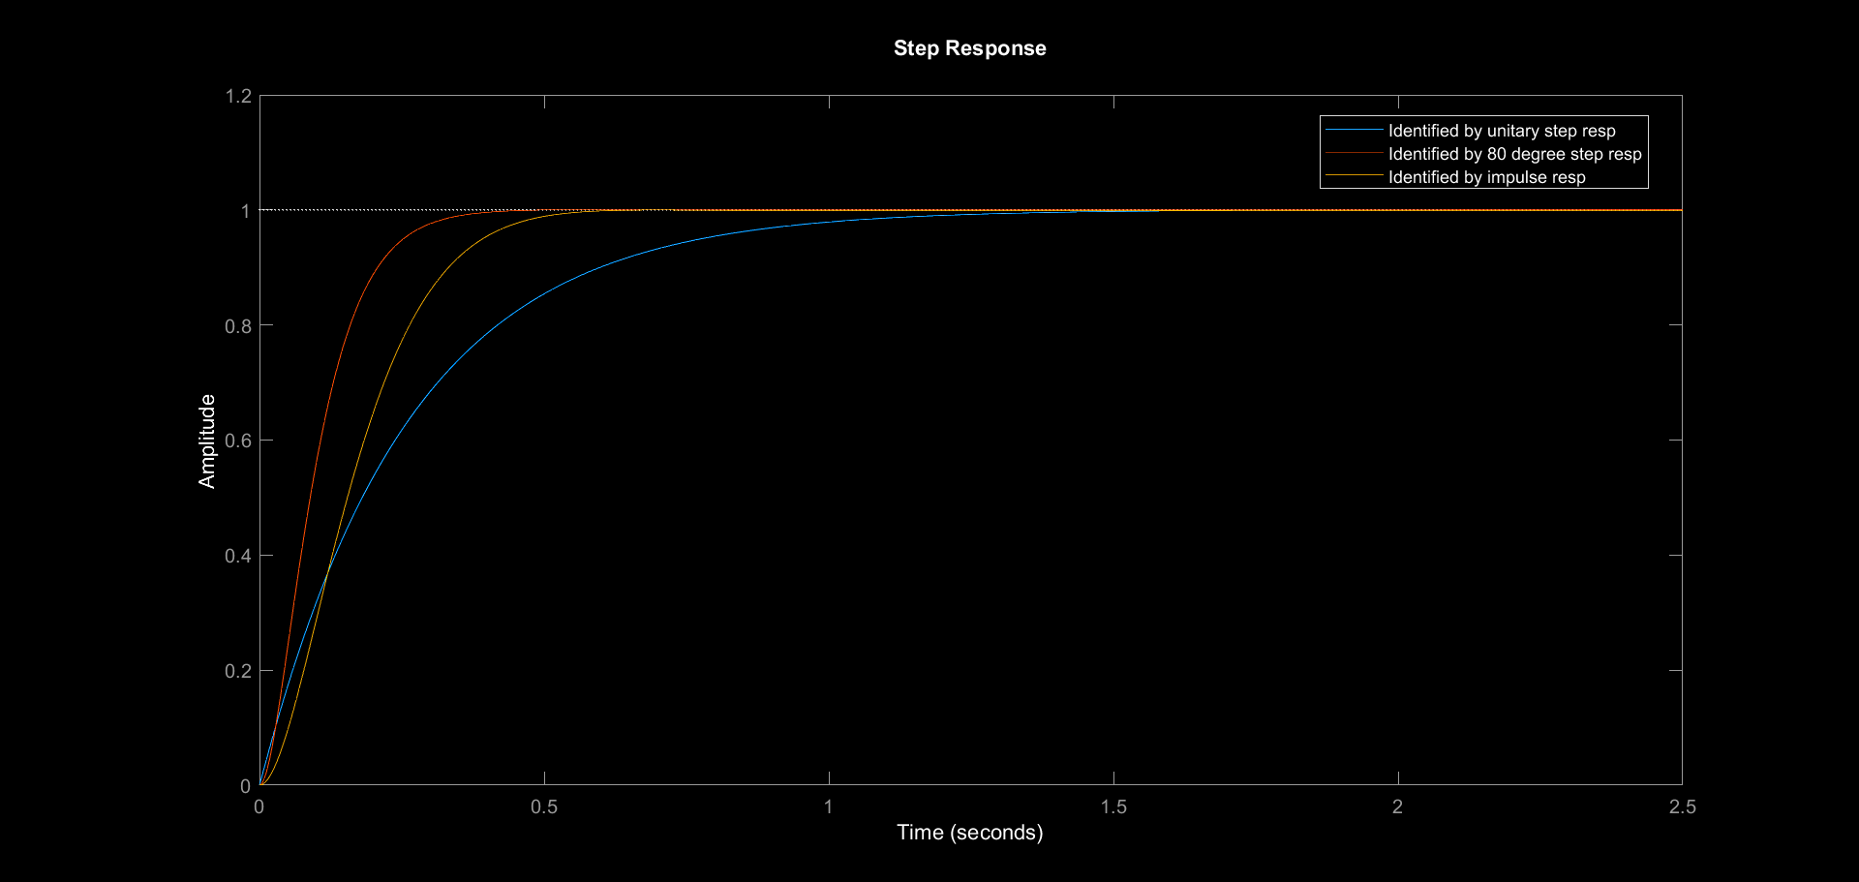
System Identification : Servo Motor Dynamics

Slide 15
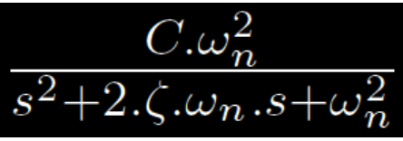
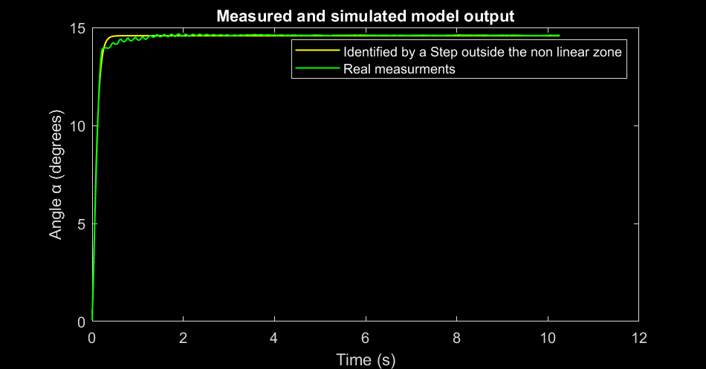
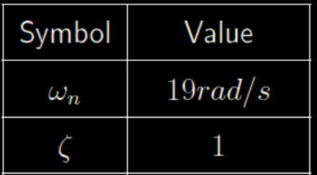
System Identification : Servo Motor Dynamics

Slide 16
System Dynamics Modelling
Need a third equation to link Alpha to Theta !

Slide 17
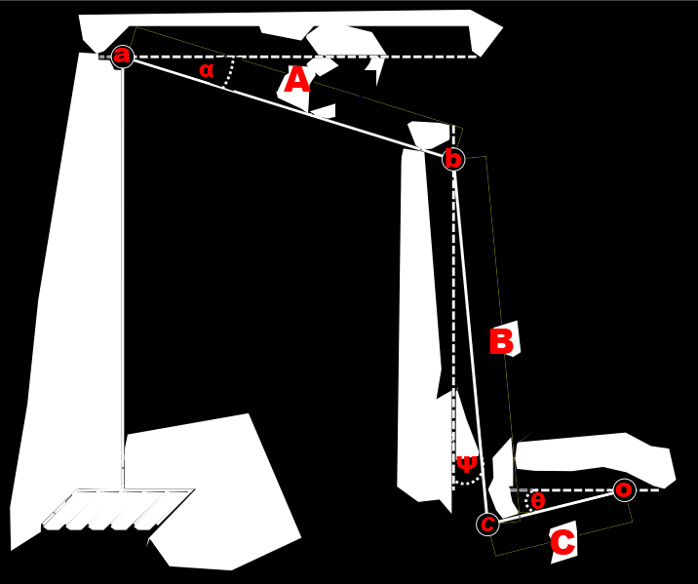
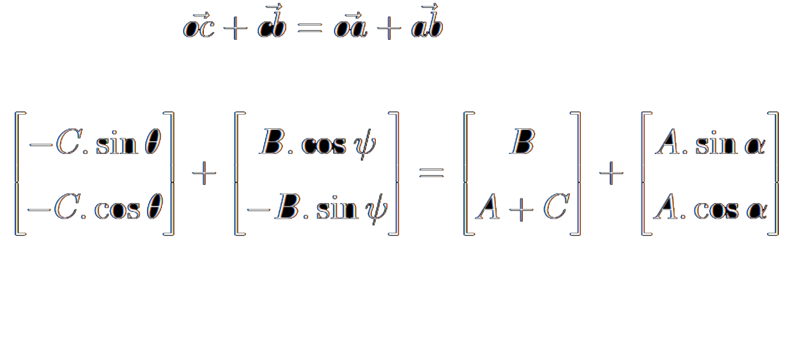
System Dynamics Modelling

Slide 18
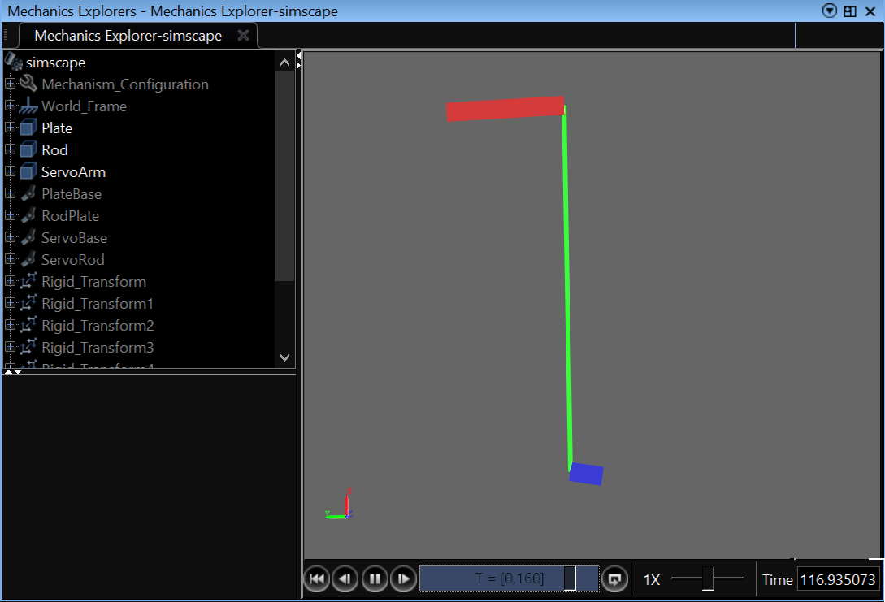
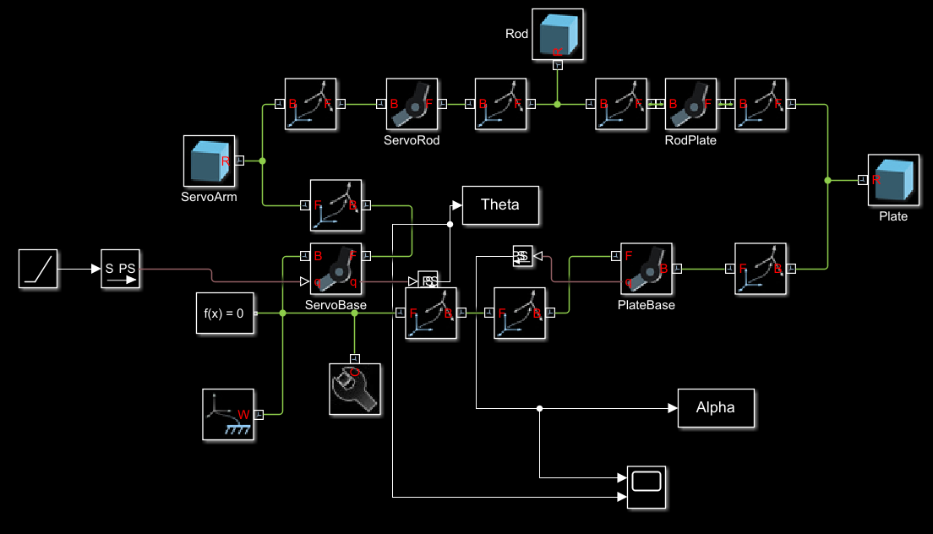
System Dynamics Modelling

Slide 19
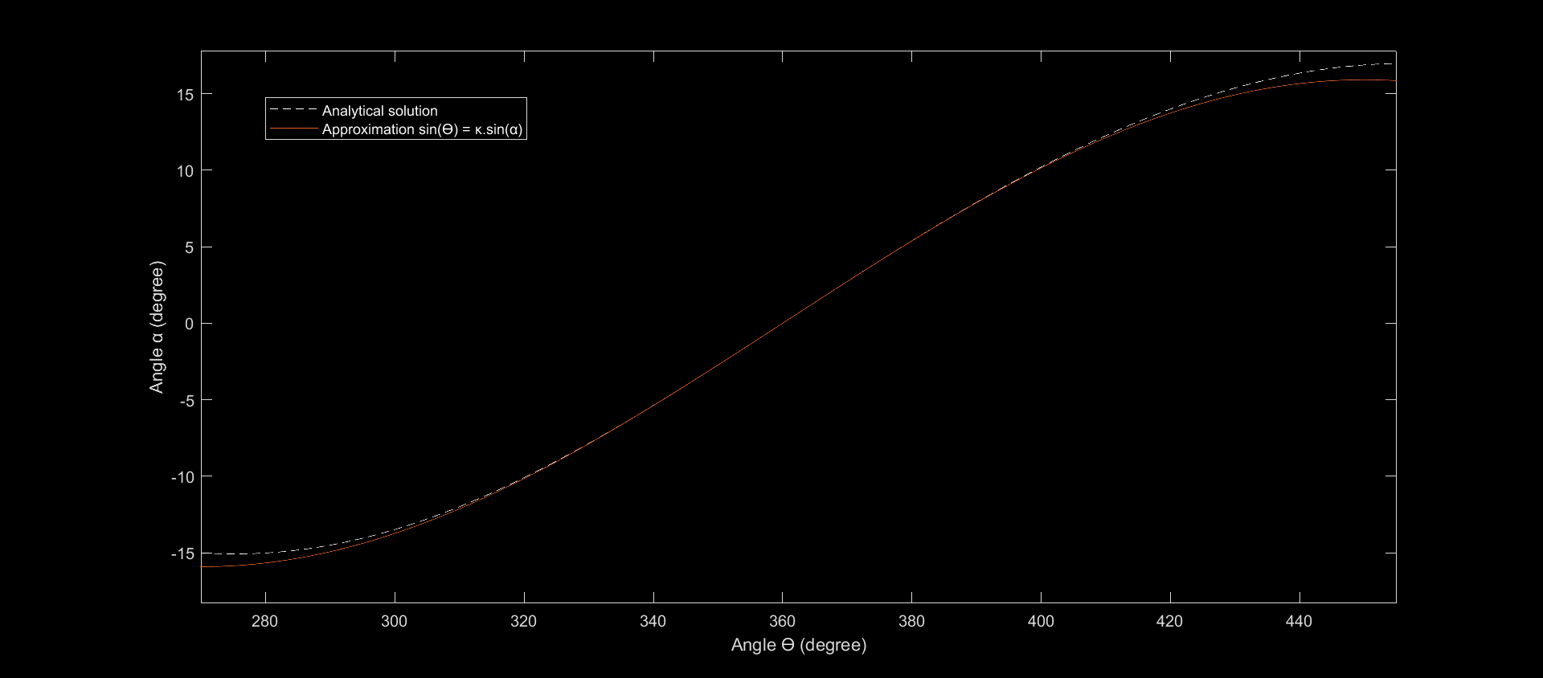
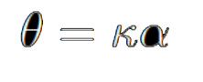
System Dynamics Modelling

Slide 20
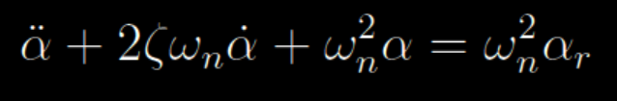
System Dynamics Modelling

Slide 21
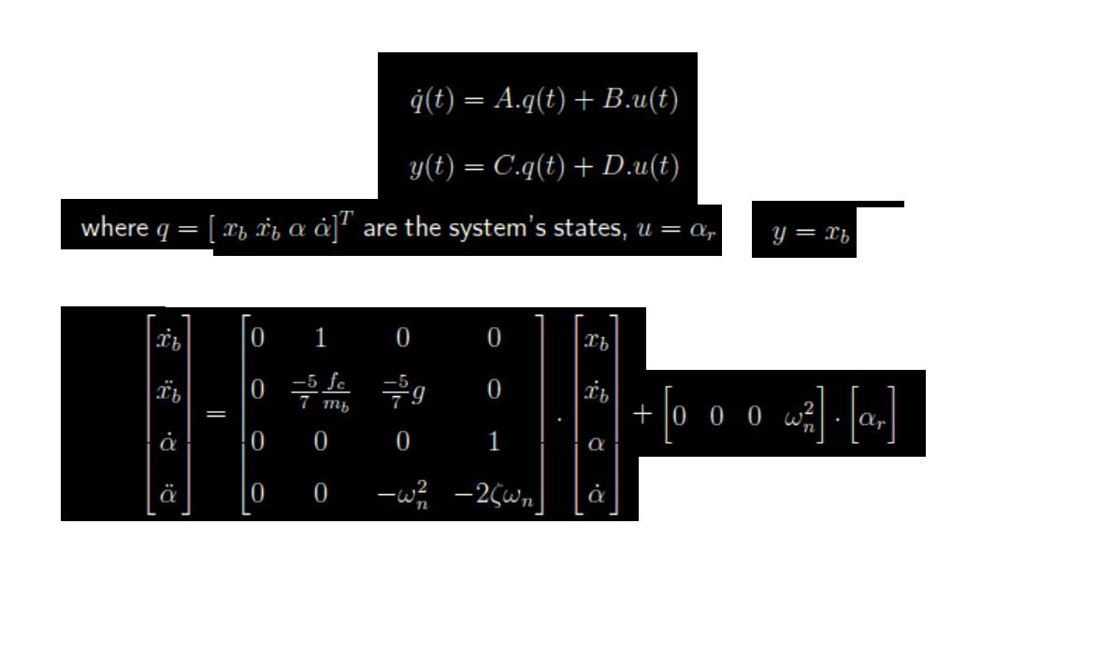
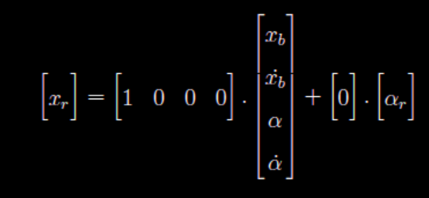
LTI State Space Model

Slide 22
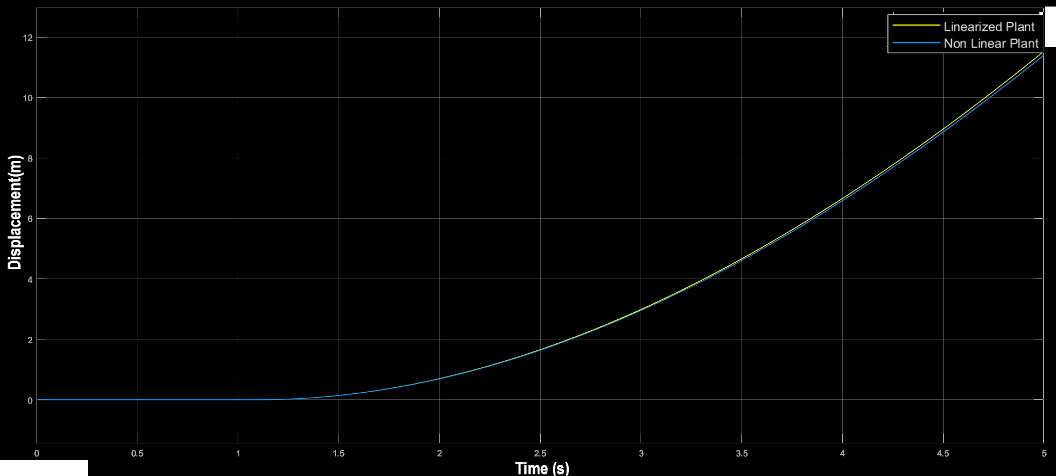
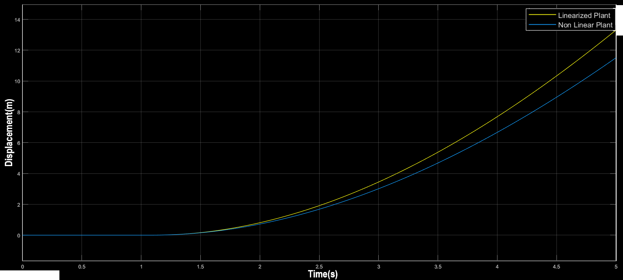
System Dynamics Modelling
Alpha < 15
Alpha > 15

Slide 23
Control Design

Slide 24
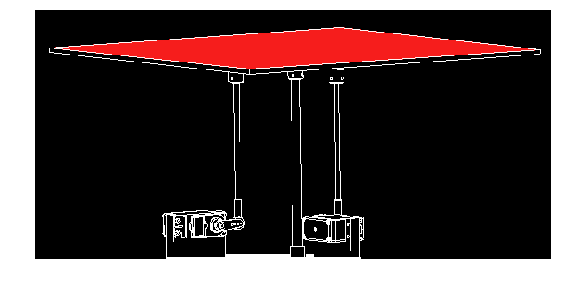
Control System Design
Interesting to check
- States of equilibrium
- Stability analysis
- Controllability Analysis
- Observability Analysis
Not BIBO Stable
Controllable
Observable

Slide 25
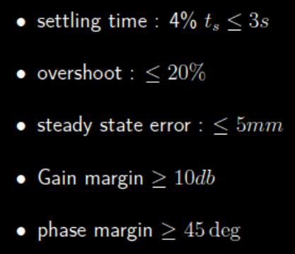
Control Requirements
Pole Placement
Loop shaping

Slide 26
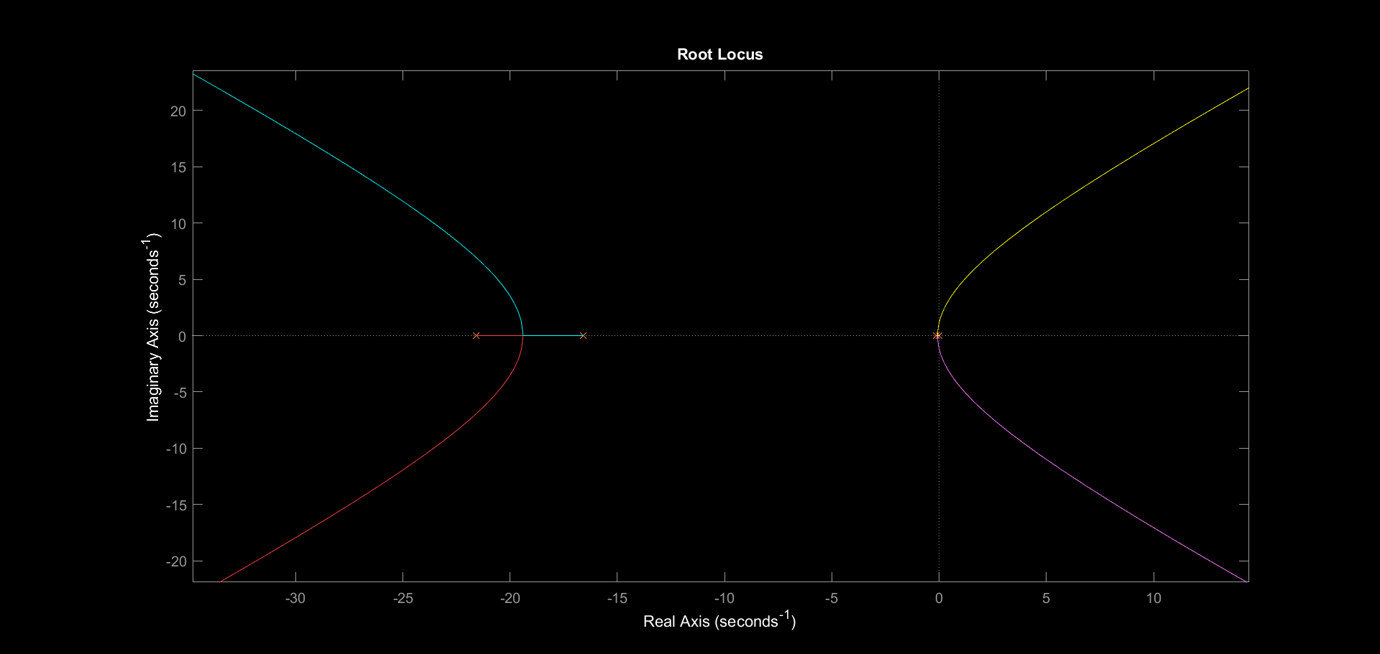
Root Locus with No Controller

Slide 27
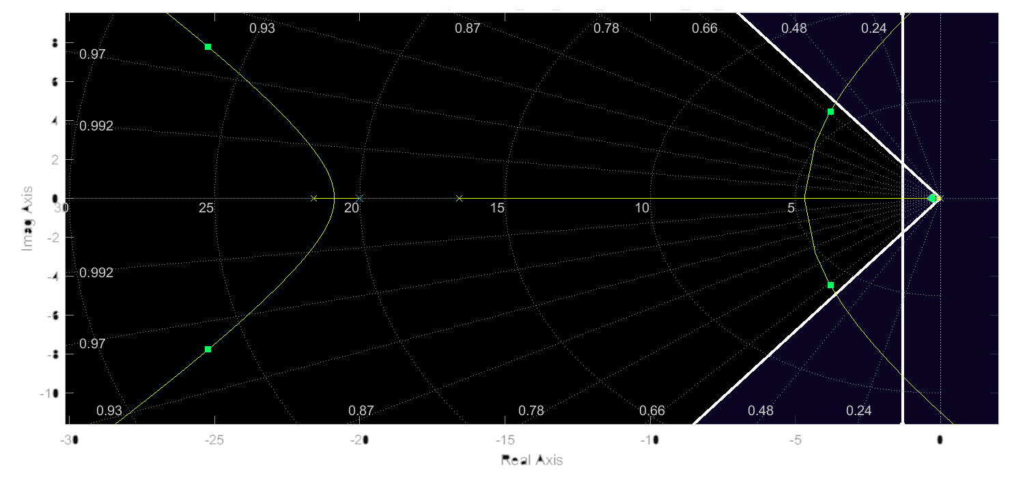
Root Locus with ( PD with low pass filter)

Slide 28
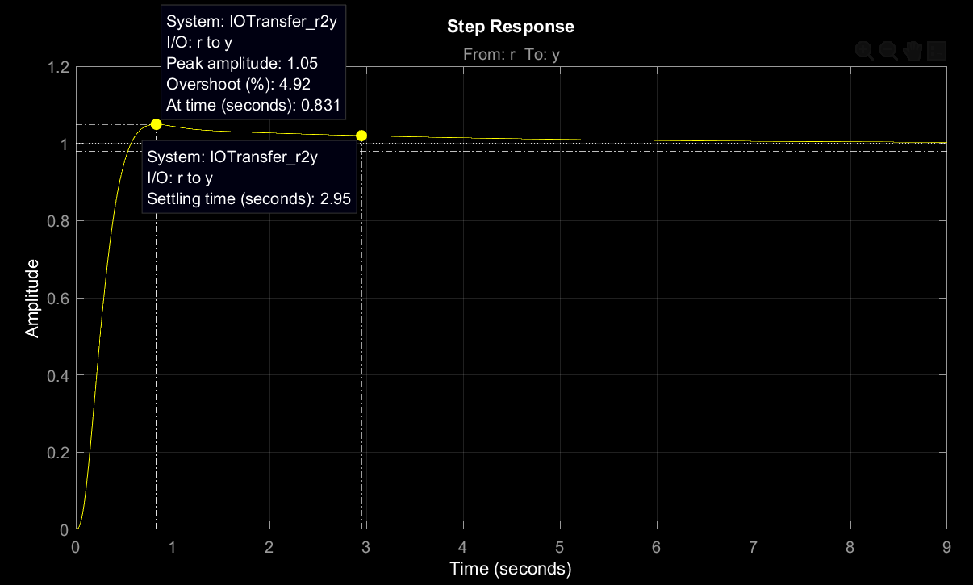
Step Response with ( PD with low pass filter)

Slide 29
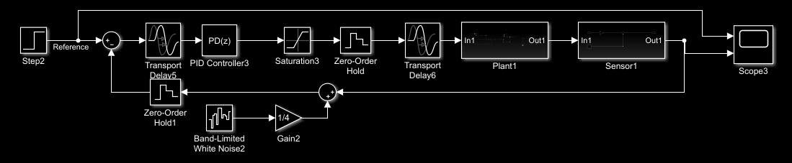
Discrete Simulink Model

Slide 30
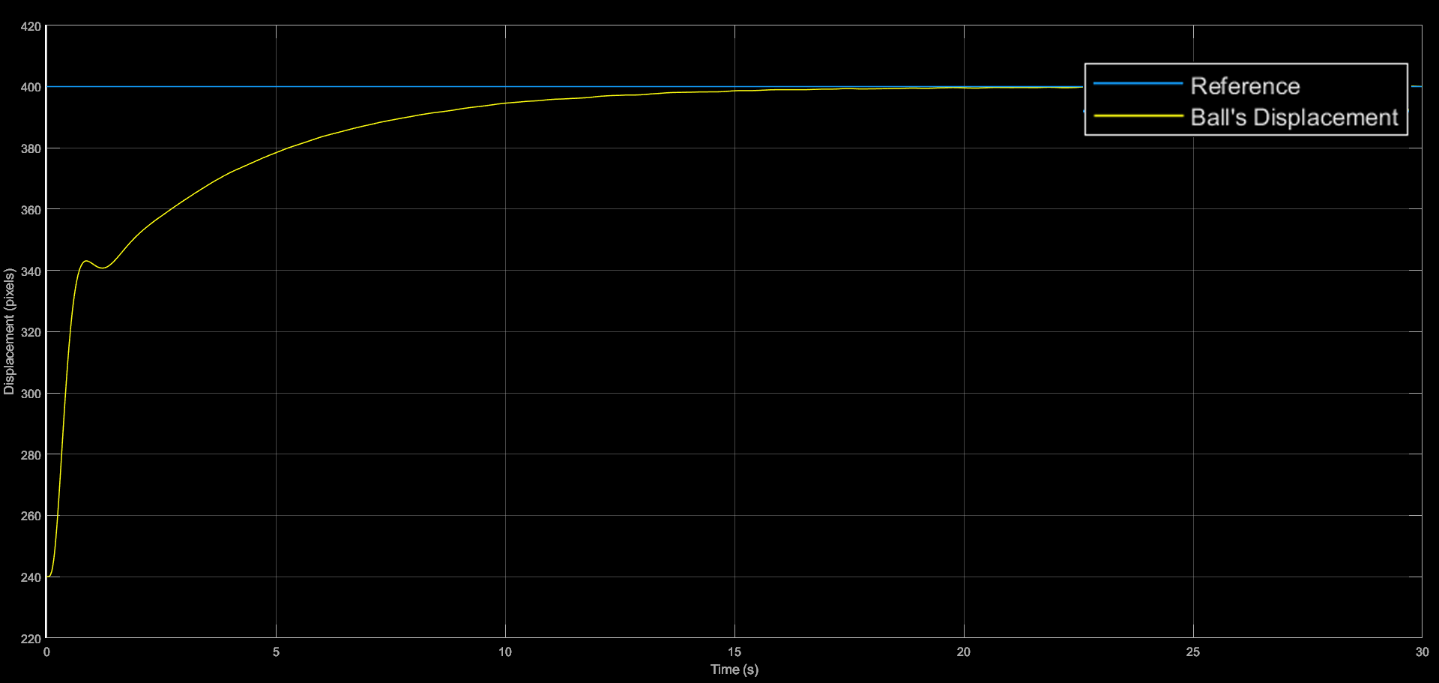
Step Response on Discrete Simulink Model

Slide 31
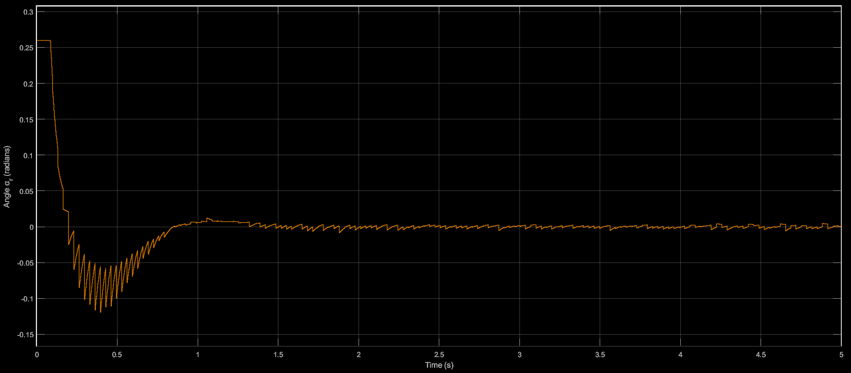
Controller Saturation

Slide 32
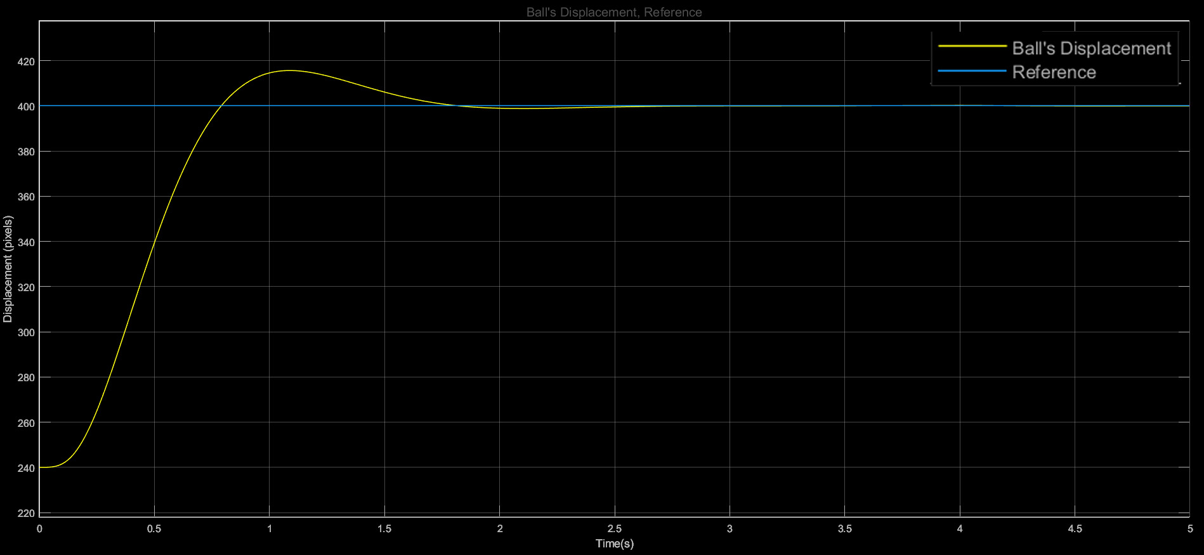
Step Response on Discrete Simulink Model

Slide 33
Validation

Slide 34
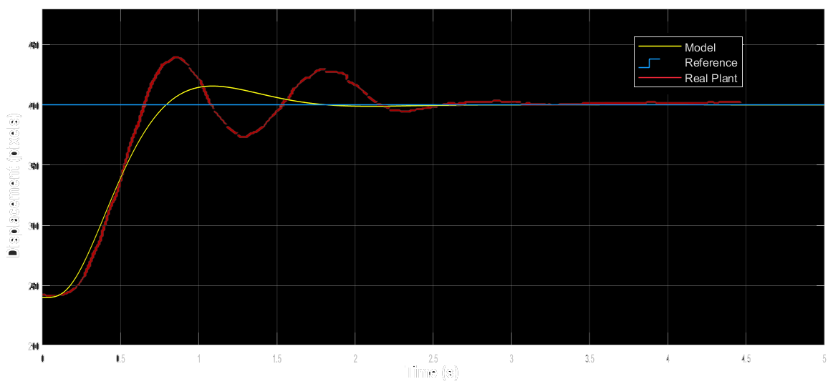
Step Response Validation

Slide 35
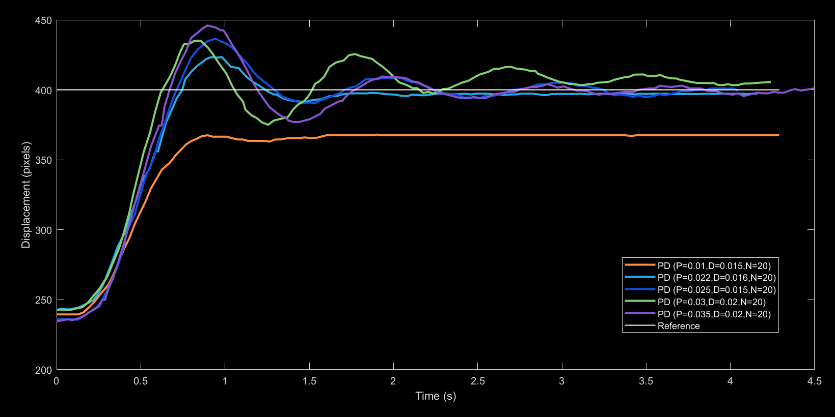
Different PD Controllers Comparison

Slide 36
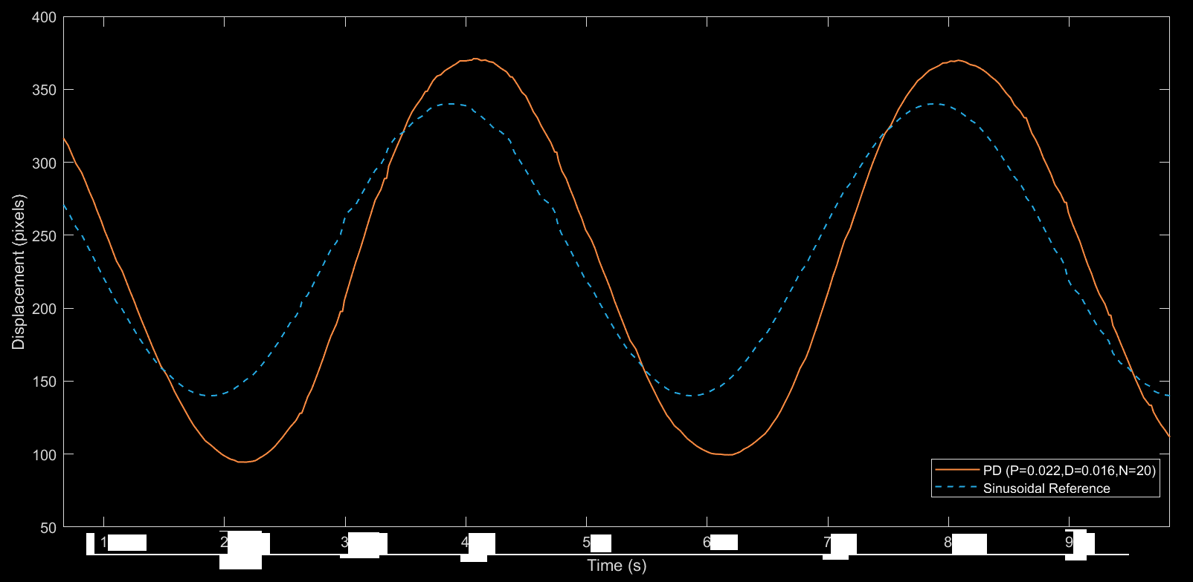
Sinusoidal Reference

Slide 37
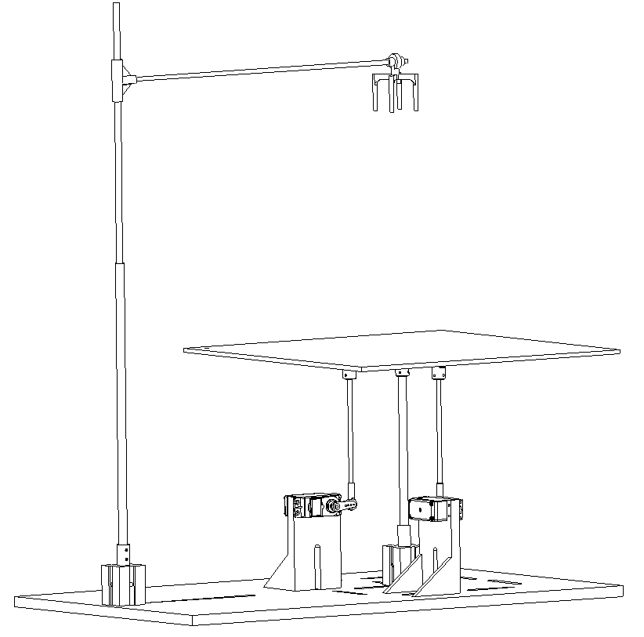
Thank You For Your Attention
Questions ?

